Slide 1
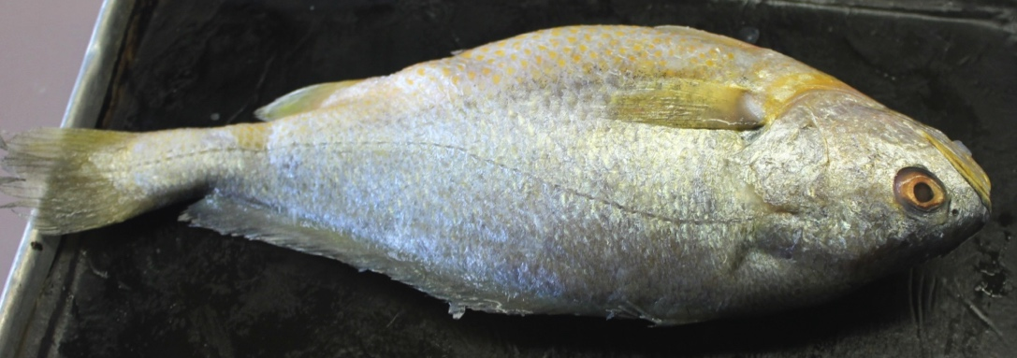
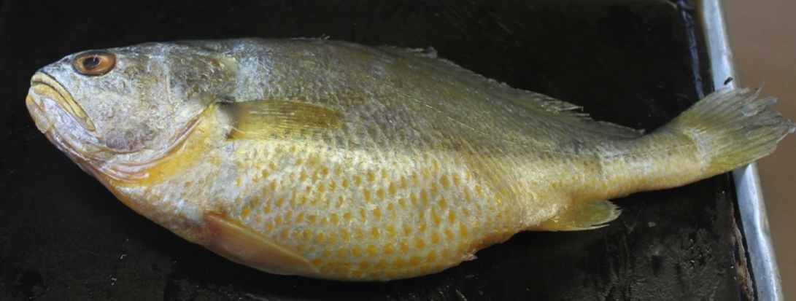
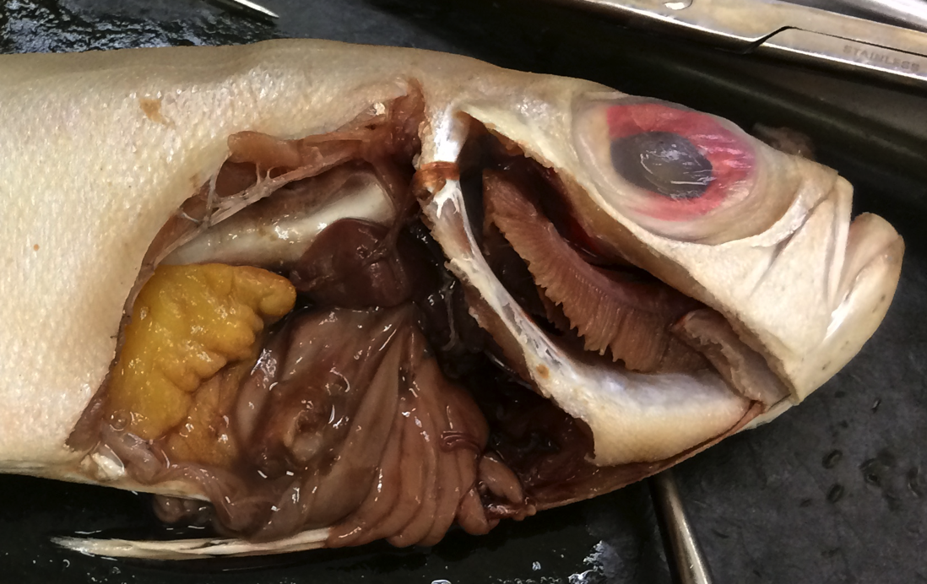
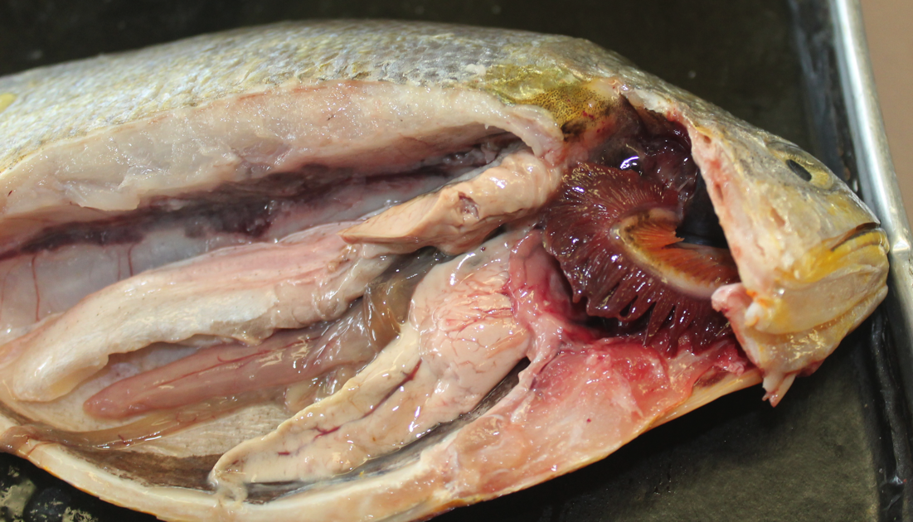
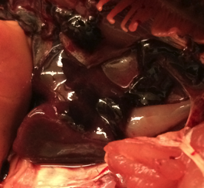
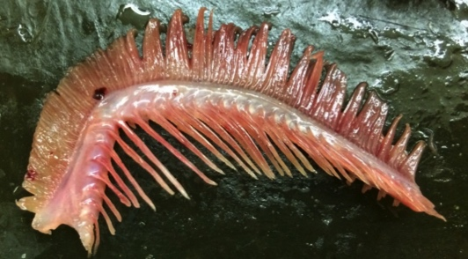
2
Bony Fish
Class Osteichthyes
10
9
5
1
8
4
Eyes
Nares
Mouth
Operculum
Lateral line
Pectoral fin
Pelvic fin
Anal fin
Dorsal fin
Caudal fin
Vent
Gill filaments
Gill arch
Gill rakers
Liver
Stomach
Pyloric ceca
Intestine
Swim/air bladder
Kidney
Heart (general)
Bulbous arteriosus
Ventricle
Atrium
Sinus venosus
Pericardium
Ovary
6
3
7
Yellow Croaker
2
1
10
9
6
4
3
8
7
11
Yellow Croaker
1
19
15
3
27
12
18
21
7
17
Female Red Big Eye
Sabrina Cornish and Carol Wenzel. 2019
24
25
25
26
20
15
22
15
14
24
19
23
22
26
23
Pulled aside
12
13
13
12
16
15
18
14
Yellow Croaker (ovaries removed)

Slide 2
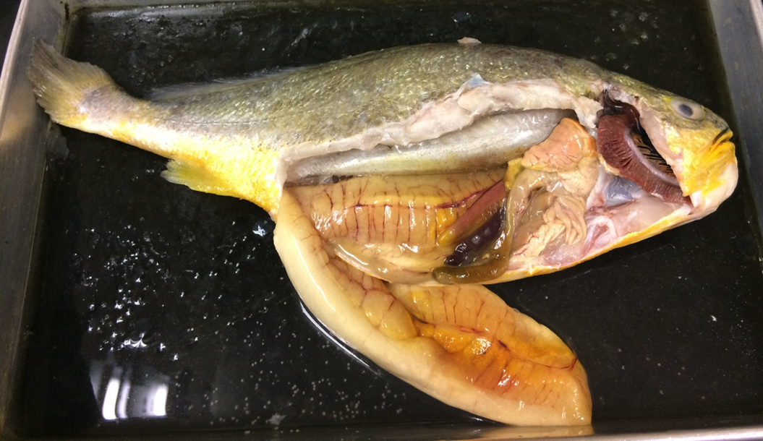
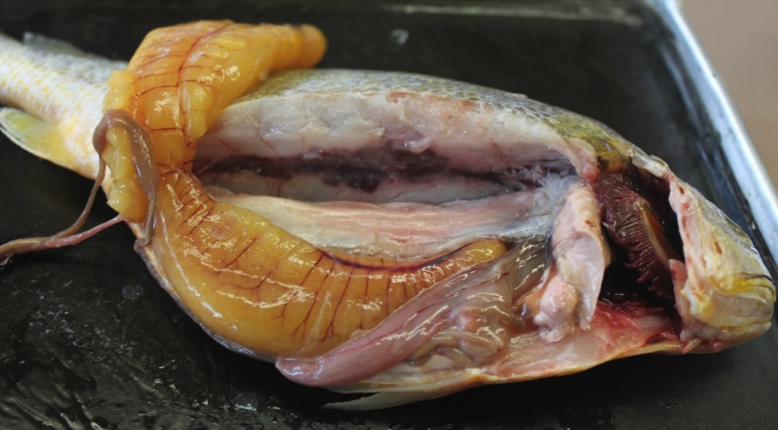

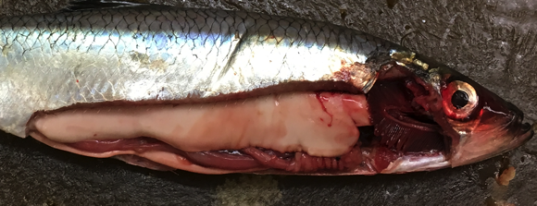
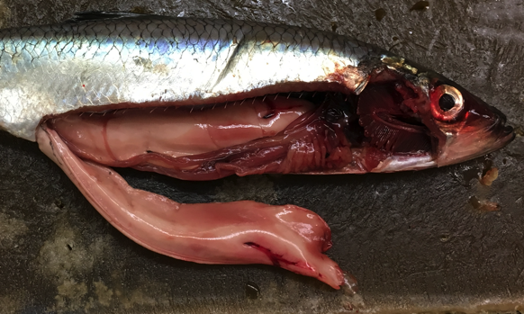
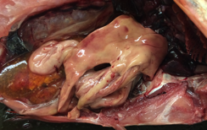
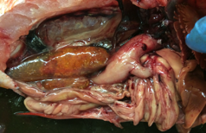
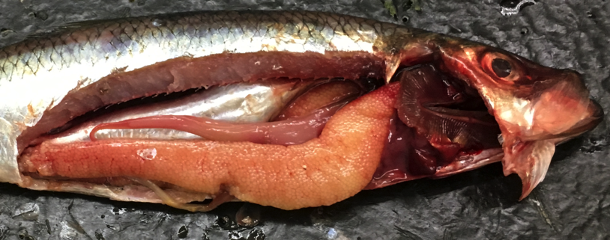
Bony Fish
Class Osteichthyes
3
12
8
5
7
3
9
6
16
10
Operculum
Pelvic fin
Anal fin
Caudal fin
Gill filaments
Gill arch
Gill rakers
Liver
Stomach
Pyloric ceca
Intestine
Swim/air bladder
Kidney
Heart
Spleen
Ovary
Egg
Testis
15
11
14
covered in
pericardium
16
8
5
16
9
11
8
14
Female Yellow Croaker
16
3
13
12 pulled aside
5
6
11
8
16
17
9
10
14
Herring ovary
2
Female Yellow Croaker
Sabrina Cornish and Carol Wenzel. 2019
13
1
18
8
11
5
16
9
11
Male Herring
10
14
2
11
18
11
5
11
13
8
5
13
5
18
10
16
14
16
9
8
Female Rock Fish
10
11
10
Male Herring
12
16
5
12
16
5
9
8
14
9
8
14
16
11
16
10
Female Herring
16
Female Herring (right ovary displaced)

