Slide 1
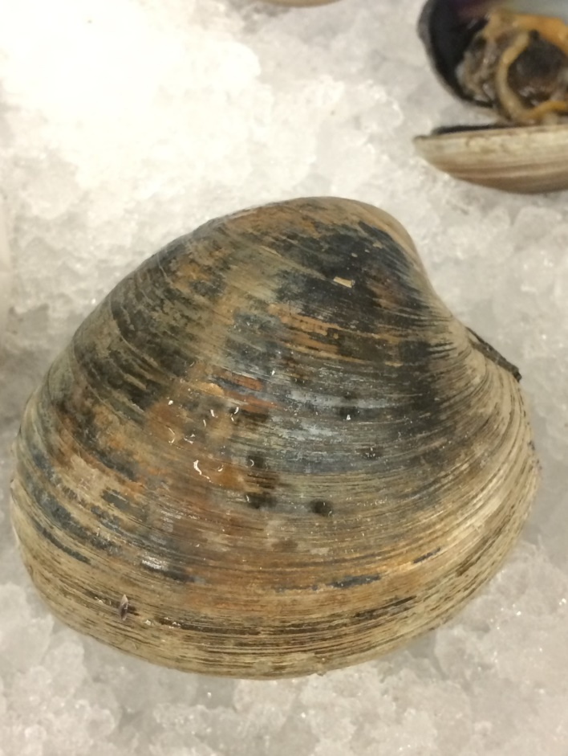
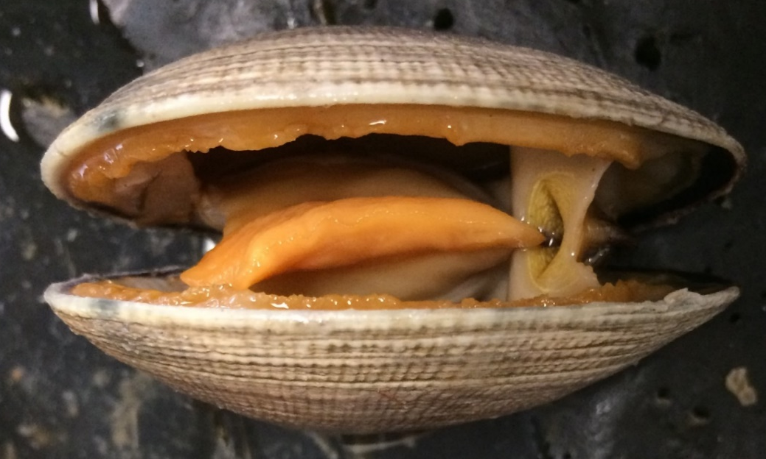
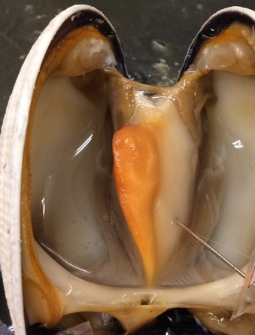
1
Manila Clam
Venerupus phillippinarum
1
3
1
4
Valve
Umbo
Hinge ligament
Growth rings
Incurrent siphon
Foot
Visceral mass
Mantle
Pallial muscle
Mouth
Labial palps
Gills
2
2
2
1
9
7
8
6
5
7
1
4
Sabrina Cornish and Carol Wenzel. 2019
5
9
9
8
8
9
12
12
6
6
1
8
7
8
1
7
7
1
11
11
10
2
10
2

Slide 2
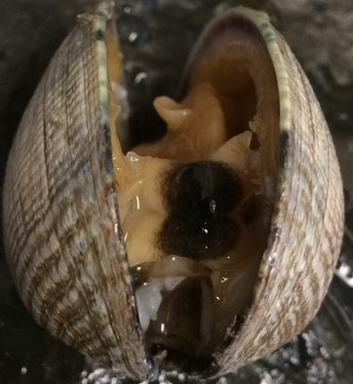
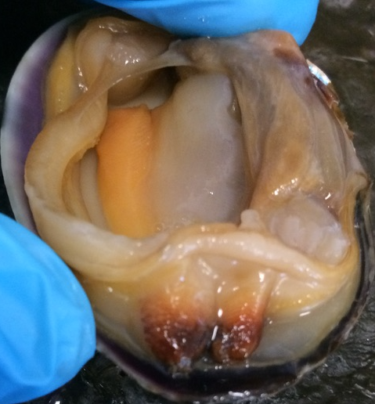
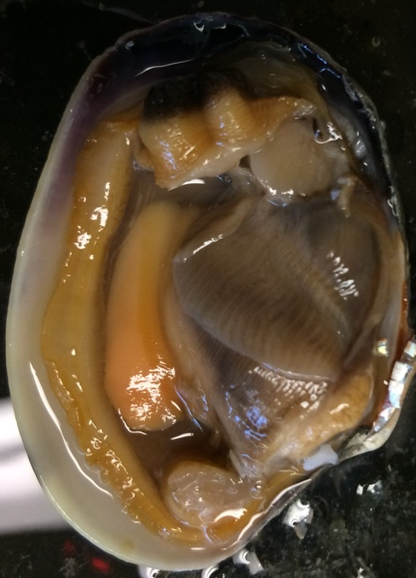
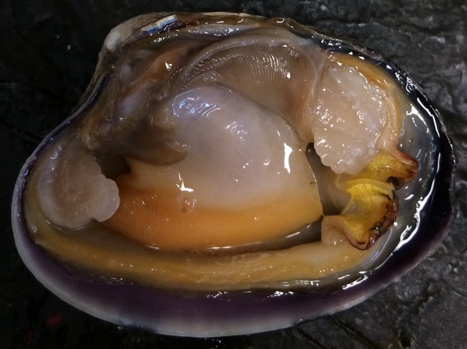
9
Manila Clam
Venerupus phillippinarum
4
9*
6
2
4
5
1
1
3
Valve
Incurrent siphon
Excurrent siphon
Foot
Visceral mass
Gills
Labial palps
Mantle
8*. Mantle, detached
9. Pallial muscle
9*. Pallial muscle, detached
Pallial line
11. Anterior adductor muscle
Anterior muscle scar
13. Posterior adductor muscle
14. Posterior muscle scar
2
3
3
13
Siphons cut open
3
2
2
9
13
6
5
6
4
9
4
5
1
1
7
11
11
11
12
9
7
4
Sabrina Cornish and Carol Wenzel. 2019
5
7
12
8
6
14
6
10
9*
14
8*
13
2
11
3
9*
2
7
8
9

