Slide 1
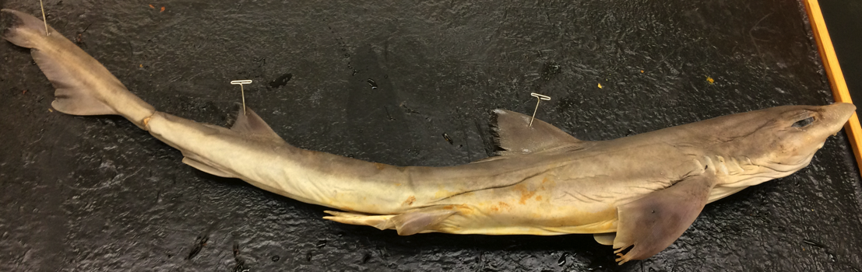
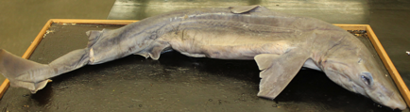
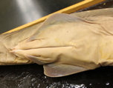
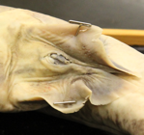
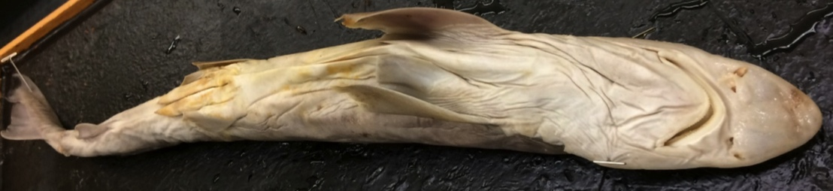
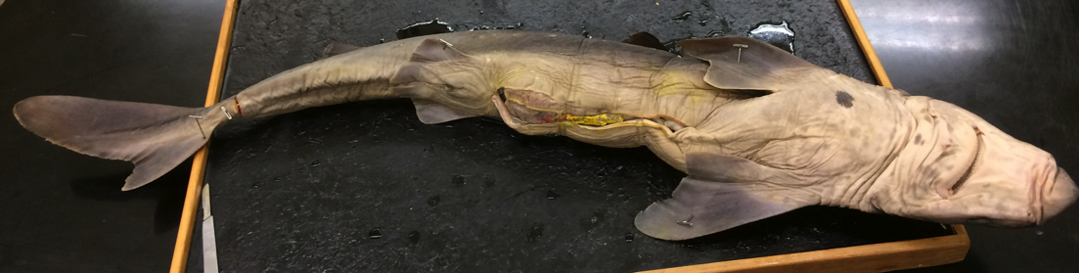
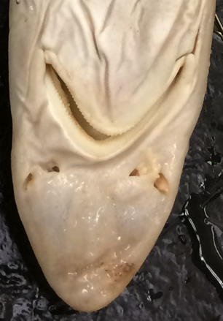
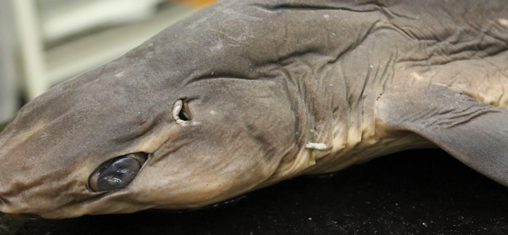
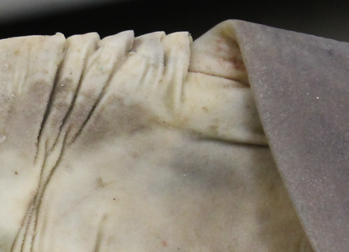
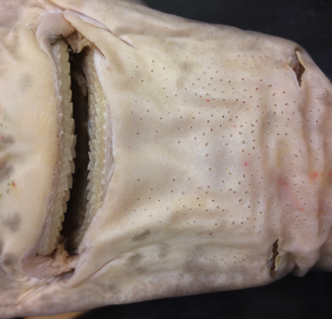
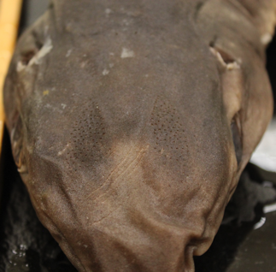
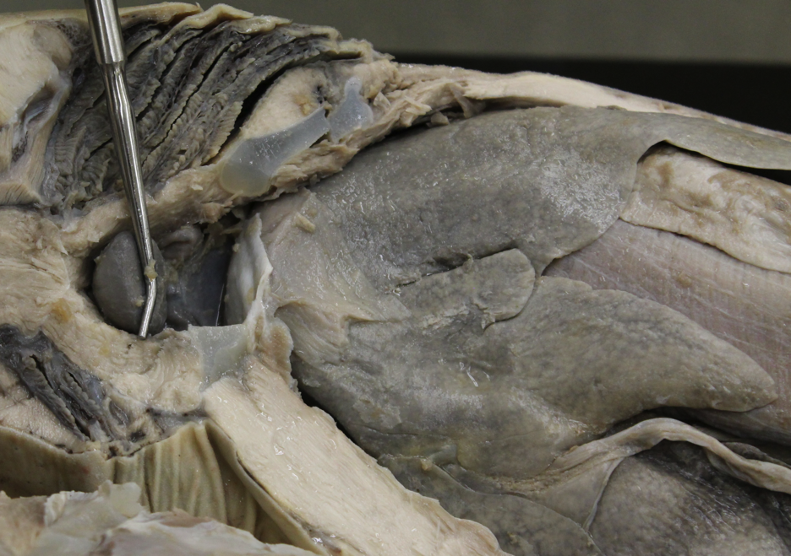
14
12
1
Spiny dogfish
Squalus acanthias
female
3
12
7
2
15
11
male
13
10
11
16
15
11
male
Lateral line
Rostrum
Eye
Spiracle
Nares
Mouth
Gill slits
Internal gills
Ampullae of Lorenzini
Pectoral fin
Pelvic fin
Dorsal fin
Anal fin
Caudal fin
Male claspers
Cloaca
Liver
Gall bladder
Stomach
Ovary
Pericardium
Ventricle
Atrium
Conus arterios
Sinus venosus
11
10
female
15
16
10
14
13
11
6
2
male
11
10
14
6
10
2
female
5
7
4
6
2
10
3
5
4
3
5
10
7
6
9
9
5
4
Ventral view
Ventral view
Dorsal view
Sabrina Cornish and Carol Wenzel. 2019
7
7
8
8
21
23
17
17
24
20
17
23
22
21
24
23
19
22
21
22
18
25
17
17
8
17
7
7
17
female

Slide 2
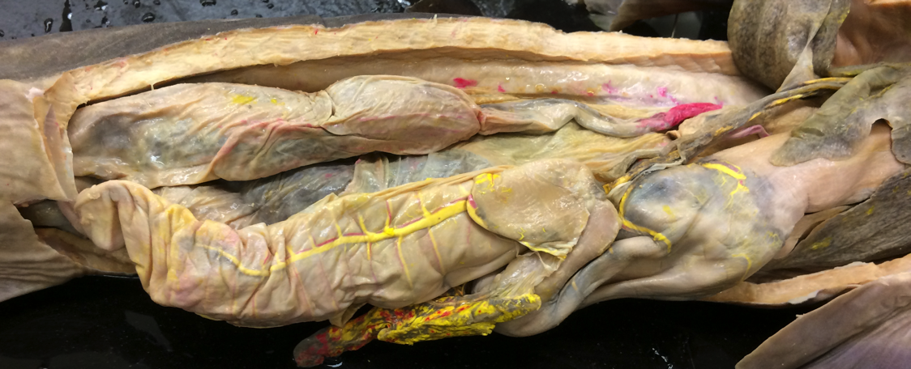
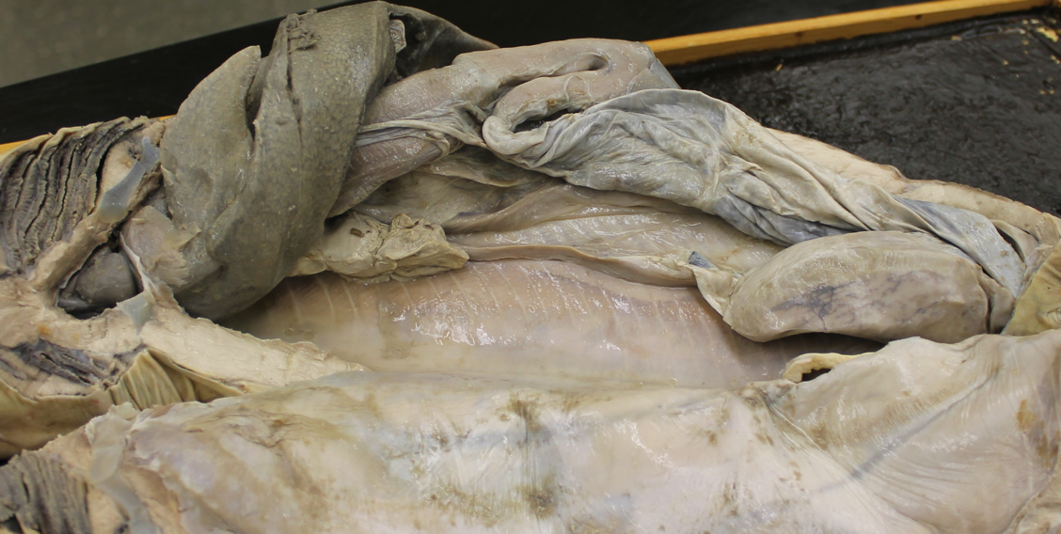
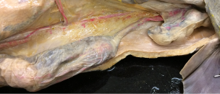
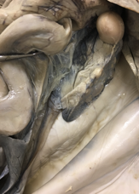
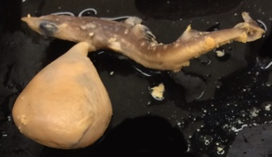
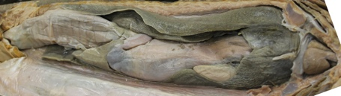
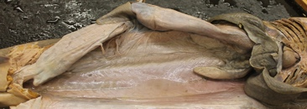
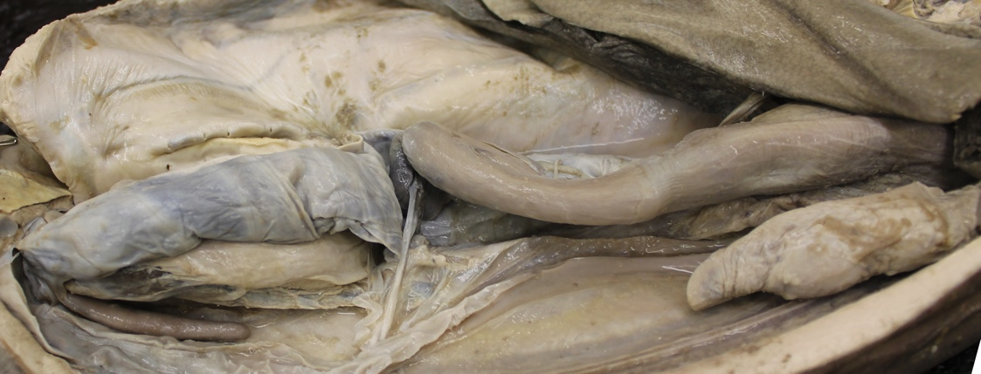
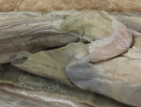
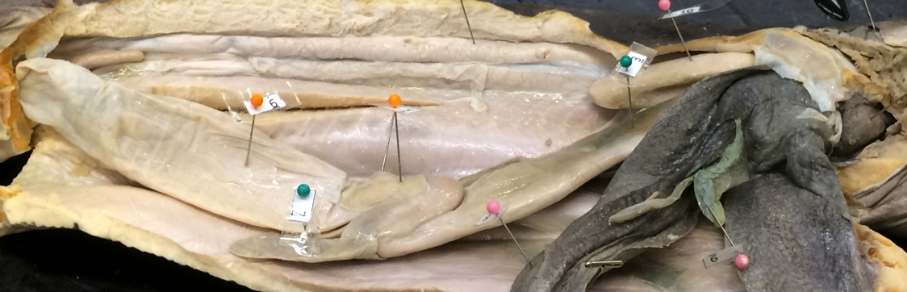
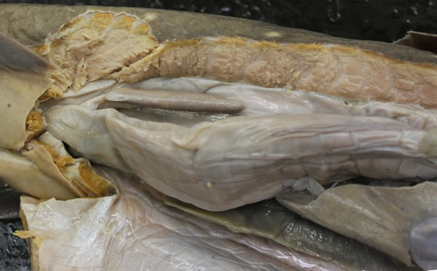
3
15
Spiny dogfish
Squalus acanthias
6
1
6
7
4
3
1
9
6
8
2
10
18
9
3
female
Internal gills
Heart (general)
Liver
Gall bladder
Esophagus
Stomach
Pylorus
Duodenum
Spiral Intestine
Colon
Spleen
Pancreas
Kidney
Rectal gland
Ovary
Follicle
Oviduct
Uterus (containing embryos)
Developing embryo
Yolk sac
Testis
Seminal vesicles
13
3
18
18
17
13
17
3
10
18
12
6
9
6
3
6
11
female
11
6
7
6
6
9
9
8
3
10
1
18
15
2
17
female
17
6
6
18
15
16
17
16
19
20
female
15
female
9
3
3
9
6
3
1
Sabrina Cornish and Carol Wenzel. 2019
male
6
21
3
21
3
3
11
immature male
6
5
9
12
9
6
10
21
11
13
14
Body wall
male
6
14
22
13
10
21
14
9
2
12
6
3
10
9
11
8
6
3
11
4
male
3

