Slide 1
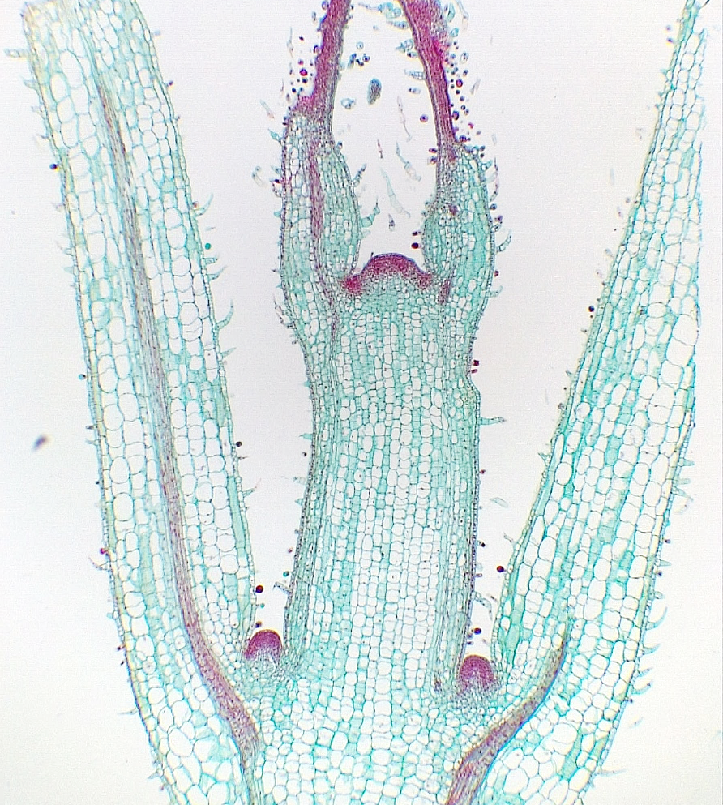
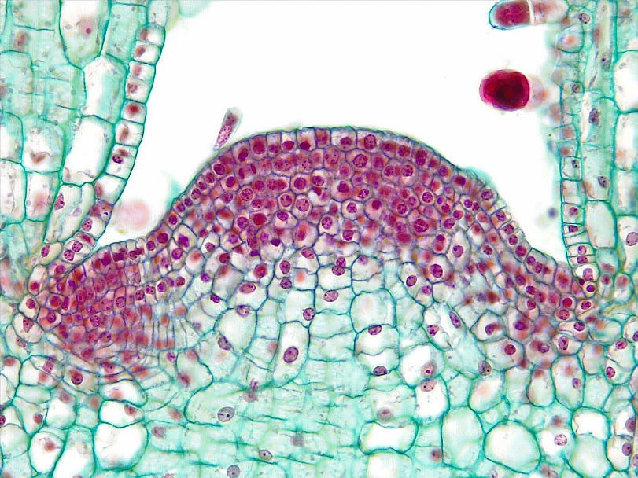
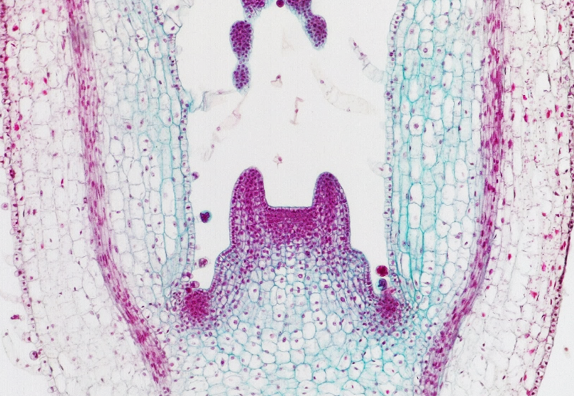
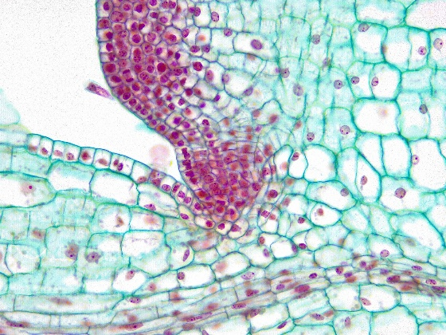
1 of 2
Stem Tip
Plectranthus scutellarioides
(Coleus)
7
1
7
Terminal SAM*
Axillary SAM
Layer 1
Layer 2
Layer 3
Leaf primordium
Older leaf
Stem
Vascular strands
*SAM = Shoot Apical Meristem
7
2
7
8
2
2
9
8
9
Longitudinal sections
Bar = 50 μm
Horton Lai and Carol Wenzel. 2020
2
1
2
4
8
7
3
3
Medial longitudinal
5
5
1
2
2
9
2
8
2
9
8
Tangential longitudinal
1
4
2
7
9
6
1
8
7
7
2
2
7
2
1
2
9
9
9
8
9
8
Leaf primordia outgrowth
Young axillary SAM
Older axillary SAM

Slide 2
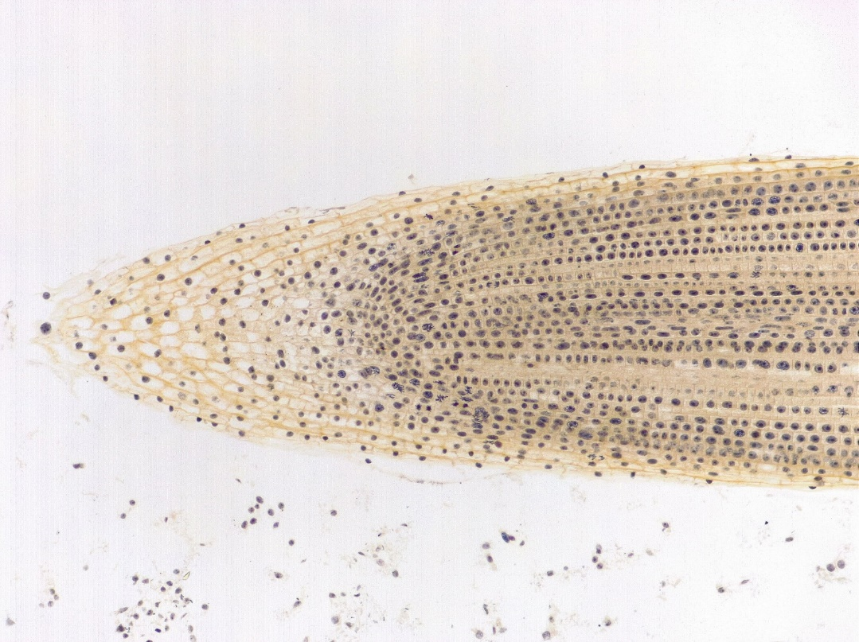
2 of 2
5
7
Root Tip
Allium (Onion)
6
4
Root cap
Root apical meristem region
Zone of division
Zone of elongation
Zone of maturation
Cell file
Nucleus
Cell wall
Nucleolus
Decondensed chromatin
Condensed chromatin
Chromosome
3
7
3
1
2
1
2
1
1
Longitudinal sections
100 μm
Bar = 10 μm
Horton Lai and Carol Wenzel. 2020
11
12
10
9
9
7
8
8
8
8
Interphase
Prophase
Metaphase
11
10
12
12
10
11
Anaphase
Early telophase
Late telophase

