Slide 1
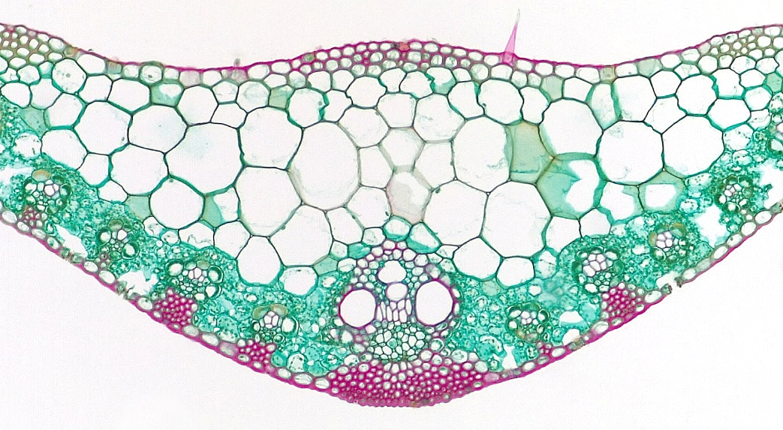
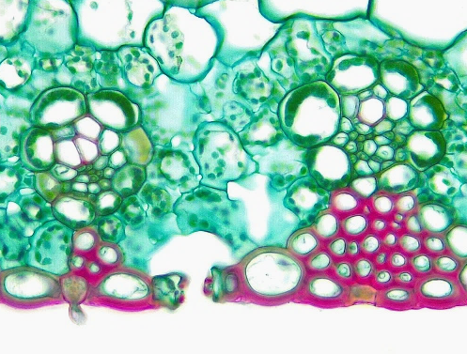
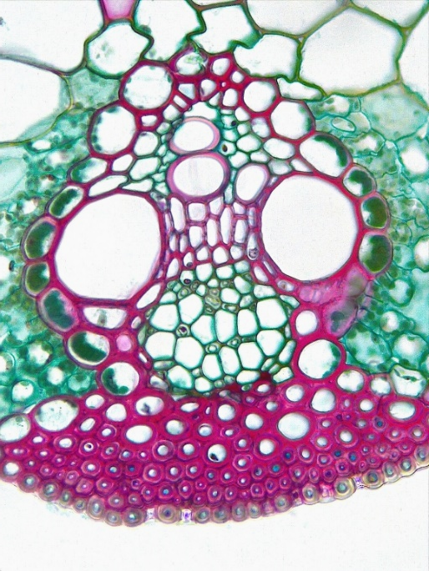
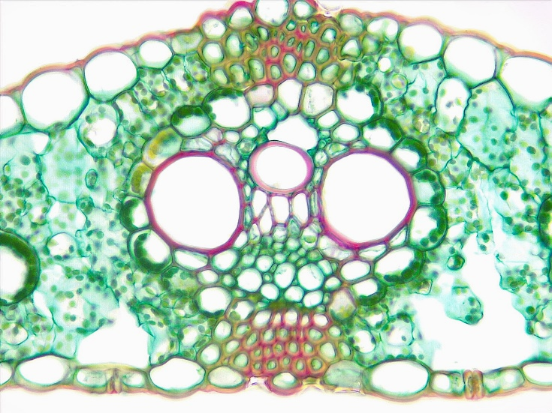
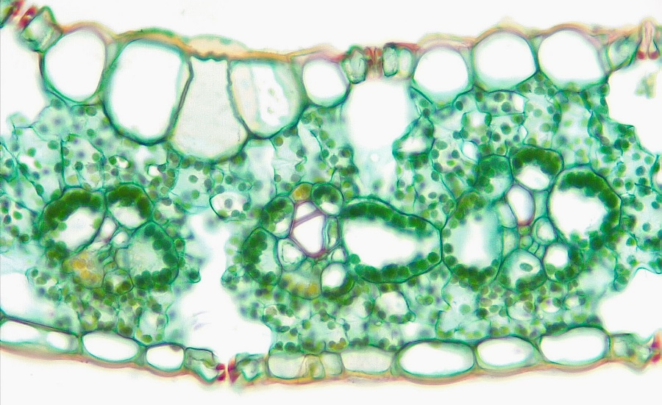
1
1 of 3
Monocot Leaf
Midrib region
Epidermis (adaxial)
Epidermis (abaxial)
Bulliform cell
Mesophyll
Vascular bundle
Protoxylem
Protoxylem lacuna
Metaxylem
Primary phloem
Bundle sheath cell
Sclerenchyma
Guard cell
Stoma
Substomatal cavity
2
2
5
6
6
`
3
6
3
12
12
12
5
6
5
6
11
11
7
11
7
14
9
9
15
12
Transverse sections
10
3
13
Bar = 100 μm
Horton Lai and Carol Wenzel. 2020
4
14
15
14
15
2
12
6
6
4
6
6
4
6
4
5
3
5
12
13
2
2
4
2
4
4
15
14
8
5
11
9
7
5
11
9
11
10
6
6
13
13
15
14
15
12
3
15
3
3

Slide 2
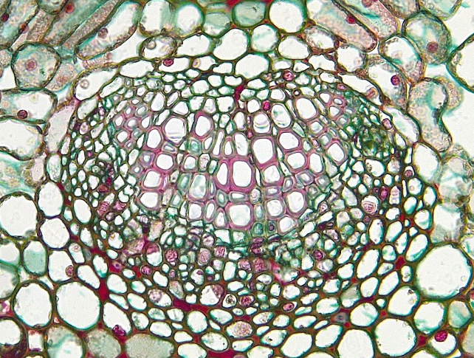
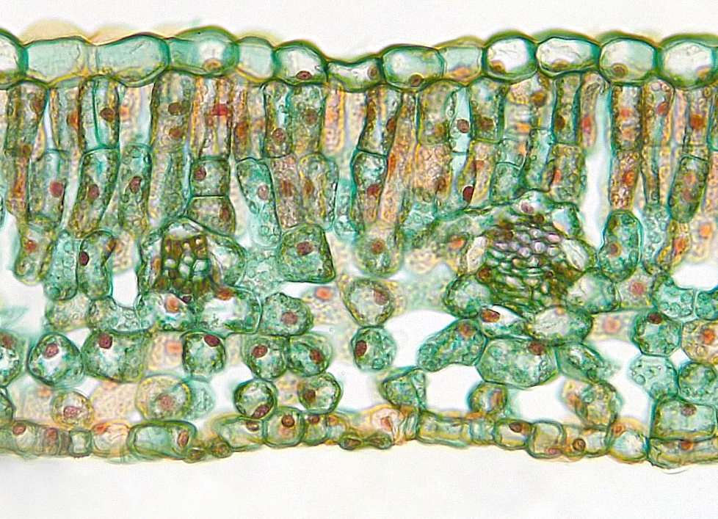
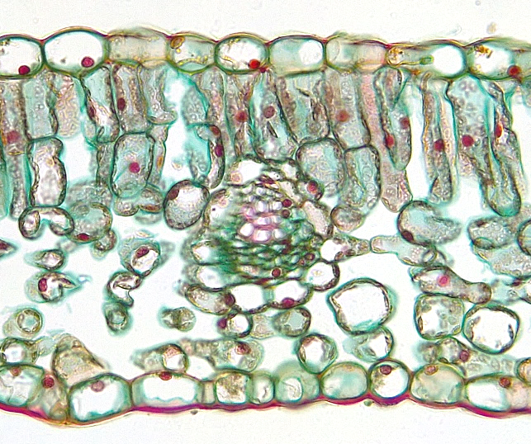
1
2 of 3
Dicot Leaf
Midrib region
Epidermis (adaxial)
Epidermis (abaxial)
Palisade mesophyll
Spongy mesophyll
Vascular bundle
Primary xylem
Primary phloem
Bundle sheath cell
Guard cell
Stoma
Substomatal cavity
2
2
4
4
5
5
6
3
3
Transverse sections
Bar = 100 μm
Horton Lai and Carol Wenzel. 2020
4
2
9
9
6
6
4
7
5
3
5
8
2
2
4
6
9
9
4
6
9
7
5
9
8
12
12
11
9
5
11
3
3
10
10

Slide 3
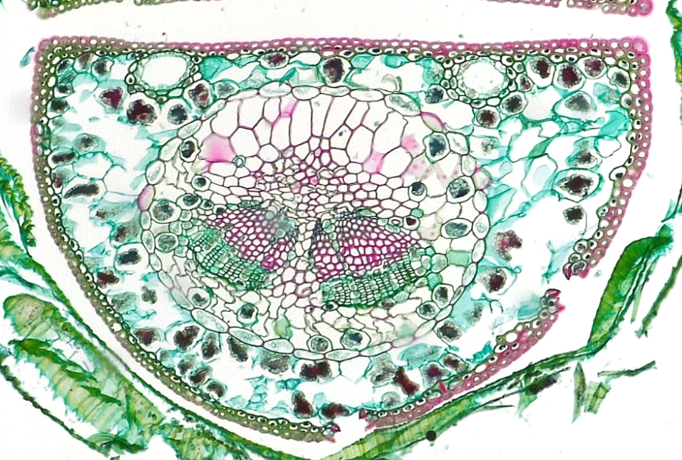
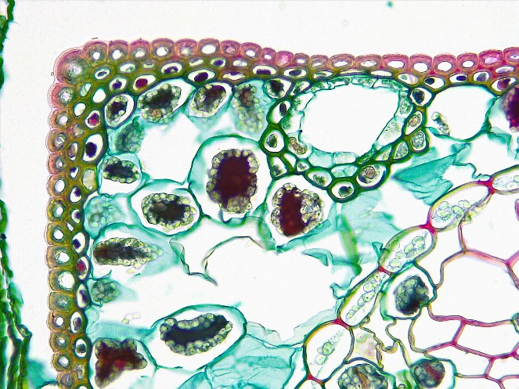
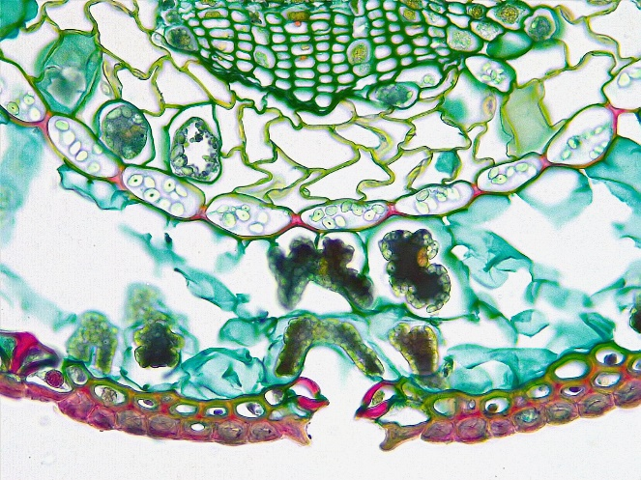
3 of 3
3
Gymnosperm Leaf
Pinus (Pine)
Needle
1
1
Needle
Fascicle sheath
Fascicle sheath remnant
Epidermis (adaxial)
Epidermis (abaxial)
Hypodermis
Mesophyll
Resin duct
Endodermis
Transfusion tissue
Vascular bundle
Xylem
Phloem
Stoma
Substomatal cavity
2
3
Section
1 cm
4
4
4
8
8
7
10
7
5
Transverse sections
11
11
Bar = 100 μm
Horton Lai and Carol Wenzel. 2020
10
4
6
5
14
3
14
8
5
7
5
7
7
8
8
9
7
9
10
9
13
12
12
10
13
13
9
6
7
7
9
10
10
7
9
15
14
7
5

