Slide 1
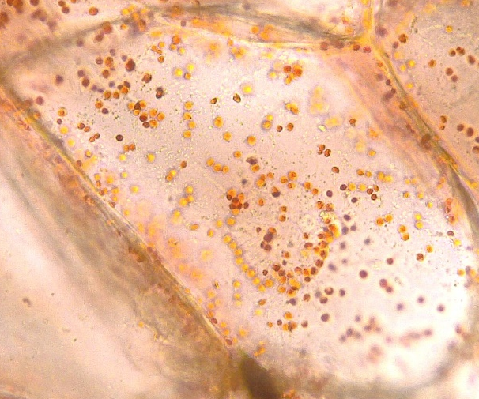
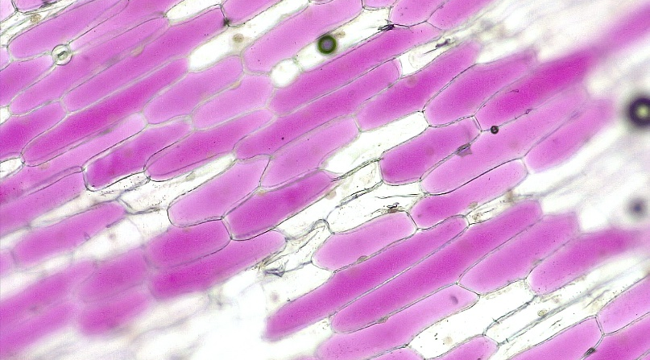
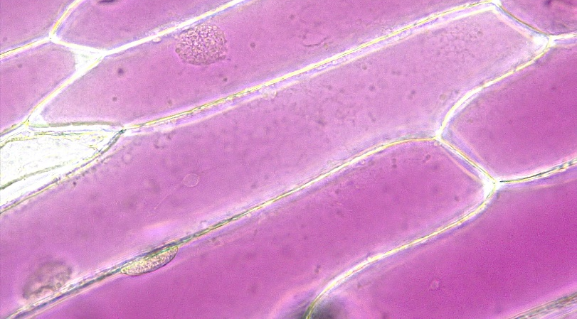
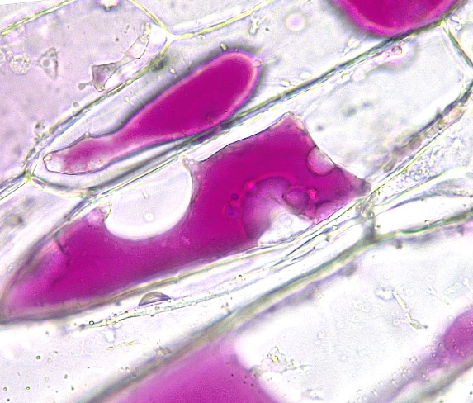
1 of 4
4
Organelles
4
Cell wall
Nucleus
Vacuole
Chloroplast
Chromoplast
Amyloplast
1
4
1
Bar = 100 μm
Horton Lai and Carol Wenzel. 2020
5
1
1
5
1
1
6
6
6
6
2
Red pepper
Potato
Potato
1
2
3
3
Damaged
3
1
2
1
3
1
2
2
3
Turgid – Red onion
Turgid – Red onion
3
1
3
2
3
1
1
Plasmolyzed
Plasmolyzed
Plasmolyzed
Progressive Plasmolysis

Slide 2
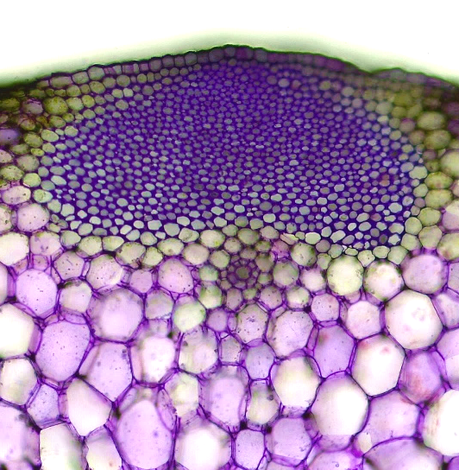
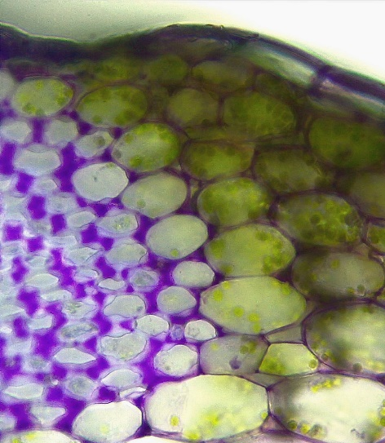
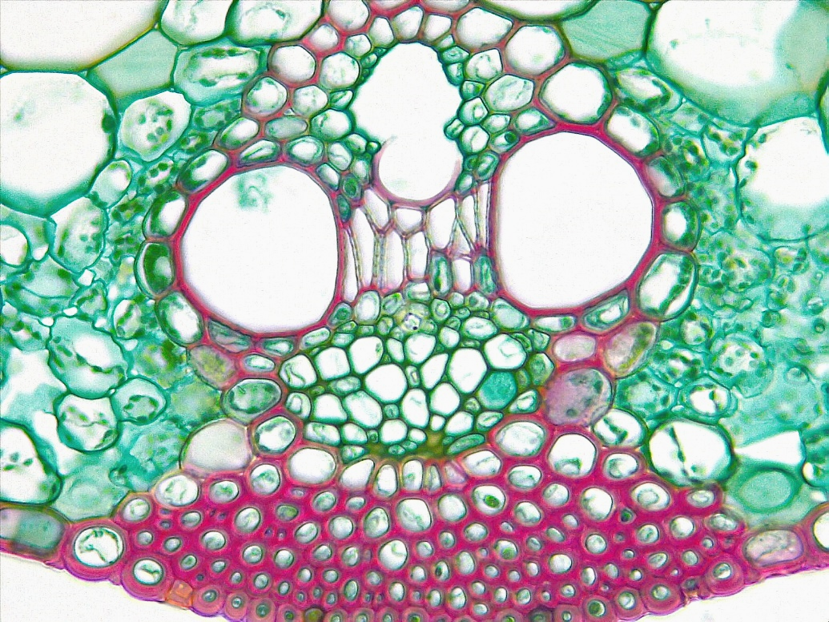
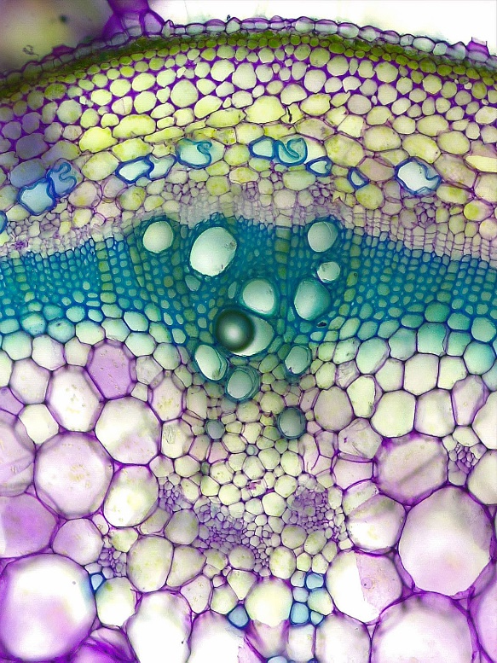
2 of 4
Cell Types
2
Parenchyma
Collenchyma
Chlorenchyma
Sclerenchyma
Xylem sclerenchyma/fiber
Phloem sclerenchyma/fiber
2
3
3
3
3
3
3
1
Celery
Celery
Transverse sections
Bar = 100 μm
Horton Lai and Carol Wenzel. 2020
1
1
3
3
3
3
3
3
3
4
4
Monocot leaf
Monocot leaf
2
6
3
2
5
6
1
6
6
5
5
5
1
1
1
Tomato
Sunflower

Slide 3
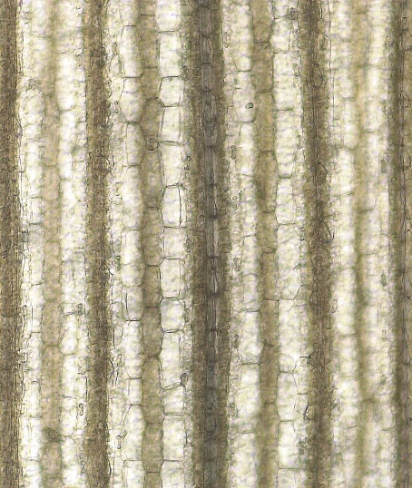
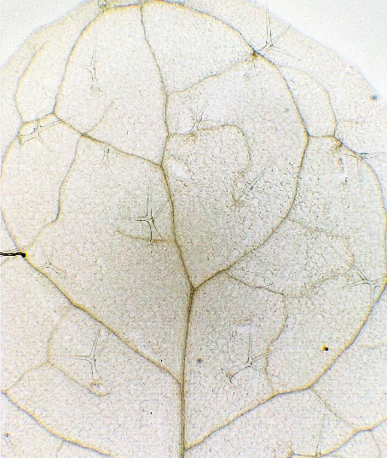
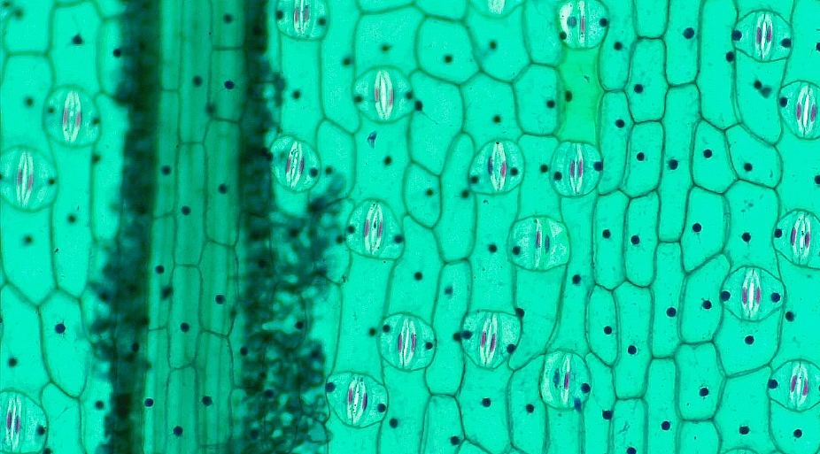
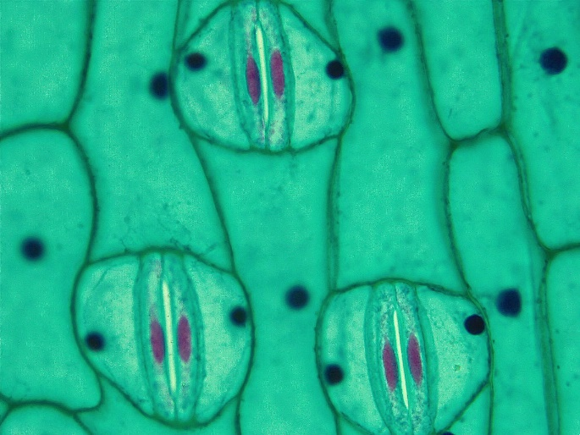
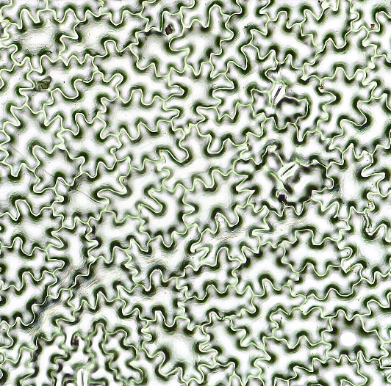
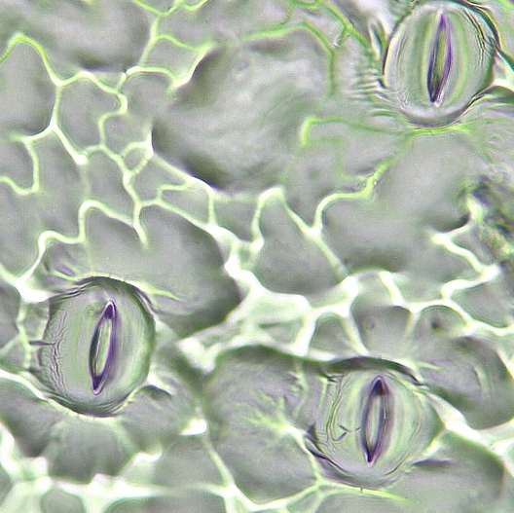
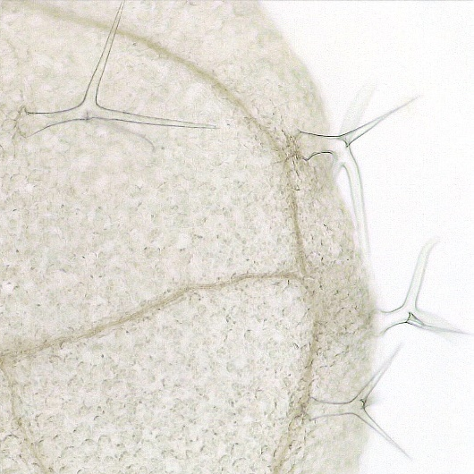
Angiosperm Leaf
3 of 4
1
1
1
1
Vein
Epidermal cell
Guard cell
Stoma
Subsidiary cell
Trichome
Leaf tooth
1
1
Monocot vein – Setaria
Dicot vein – Arabidopsis
Bar = 50 μm
Horton Lai and Carol Wenzel. 2020
1
2
5
5
4
4
2
4
2
3
2
5
2
4
5
Monocot
Monocot
1
2
4
2
4
2
4
2
3
4
2
Dicot
Dicot
Dicot
6
6
7
6
6
1
6
7
6
Arabidopsis
Coleus
Setaria

Slide 4
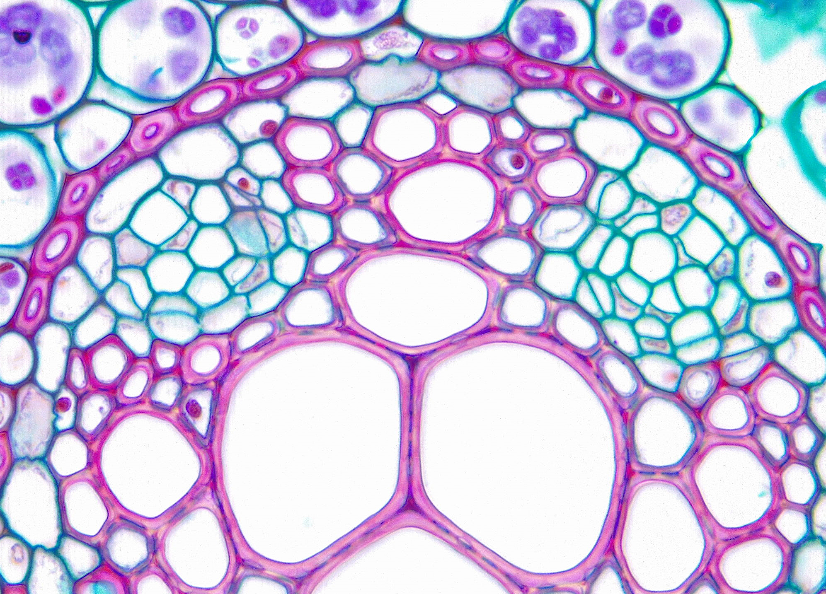
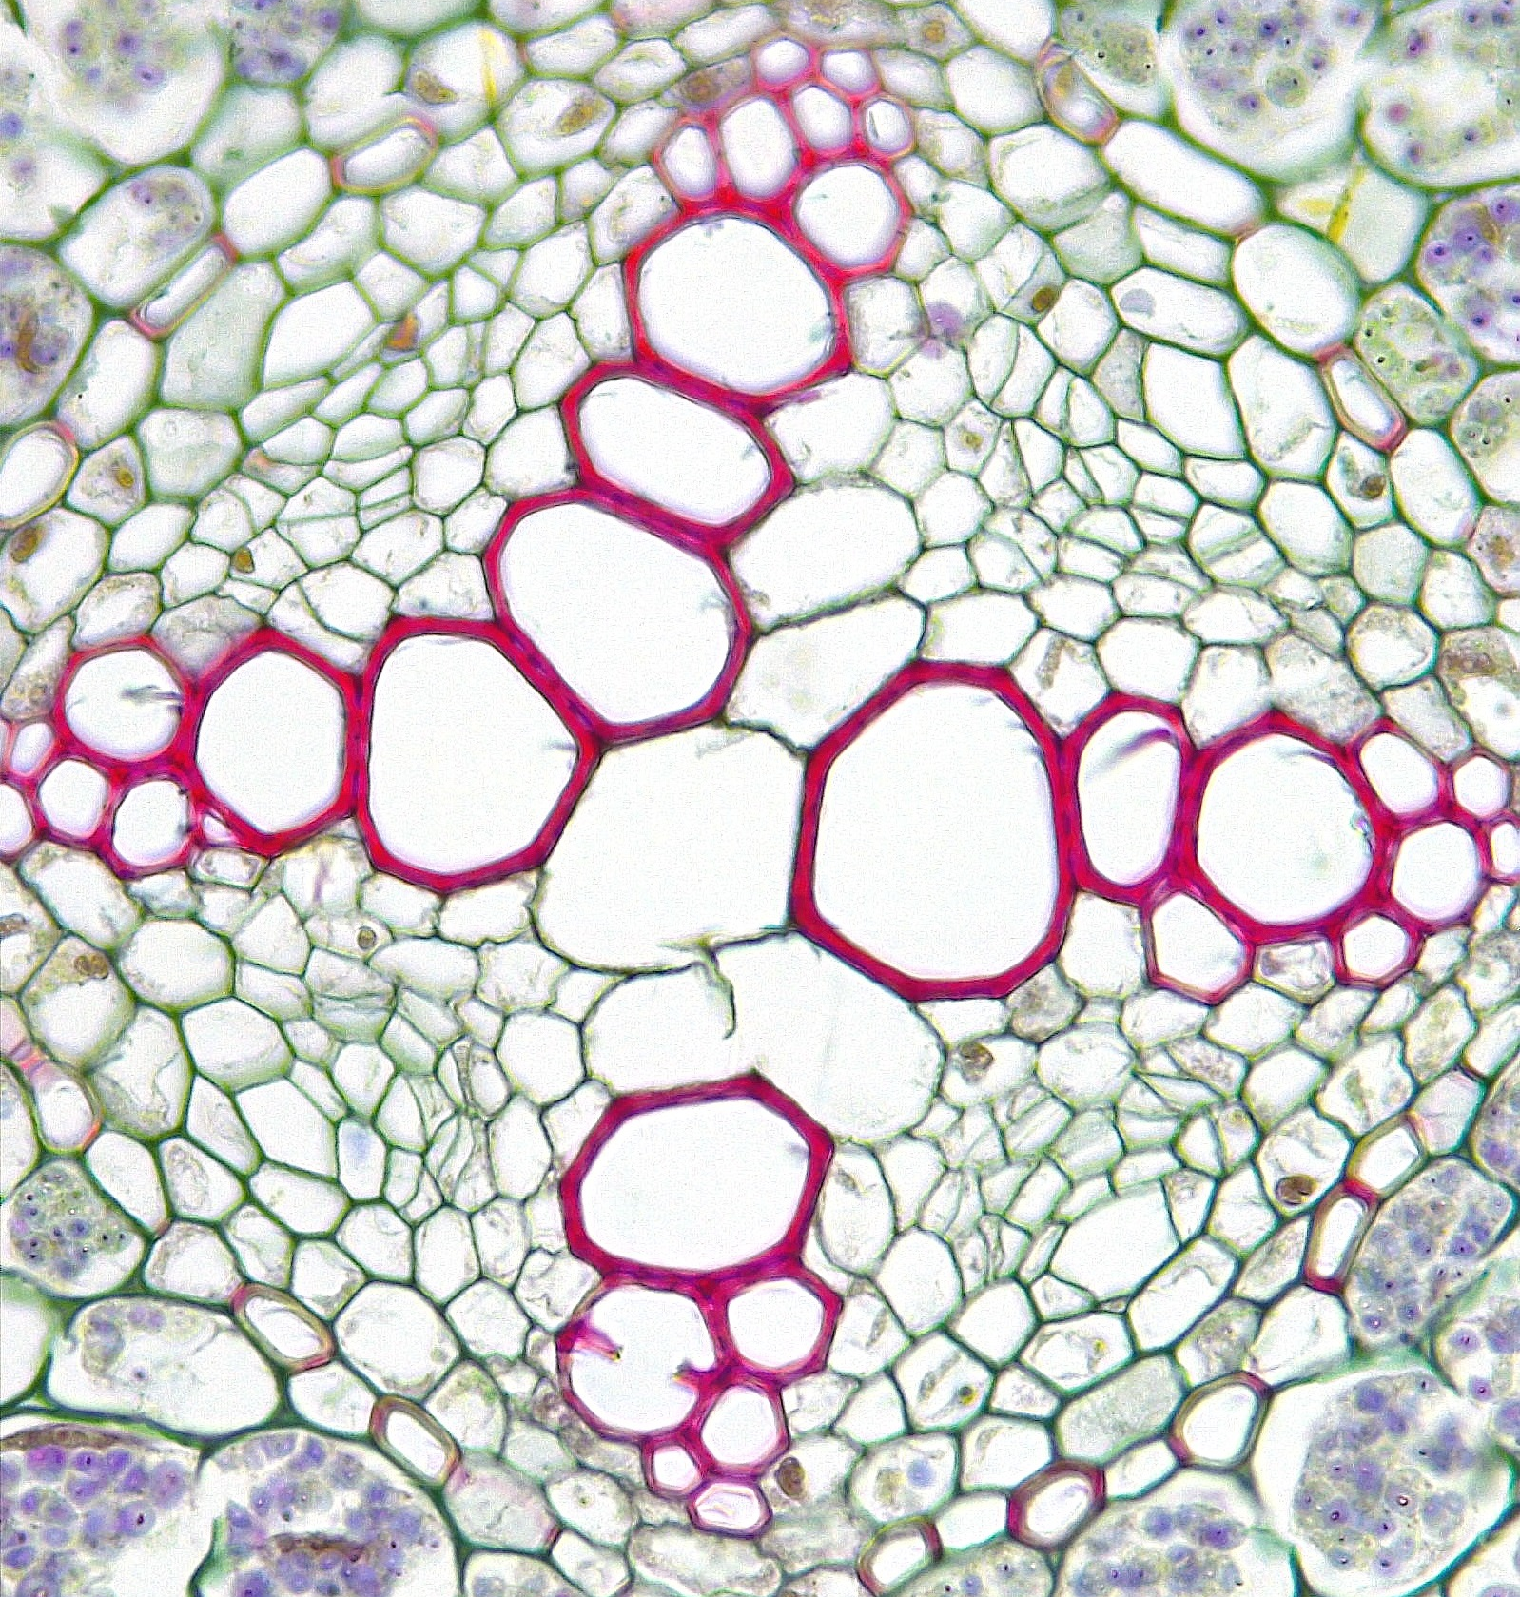
4 of 4
3
Xylem Maturation
1
Annular 2° wall thickening
Spiral 2° wall thickening
Scalariform 2° wall thickening
Simple pitted 2° wall thickening
Bordered pitted 2° wall thickening
Cell wall pit
Mature protoxylem
Immature metaxylem
Mature metaxylem
2
Tomato
Tomato
Tomato
6
Longitudinal sections
unless otherwise stated
6
4
5
Bar = 20 μm
Horton Lai and Carol Wenzel. 2020
6
6
7
4
6
Tomato
Pine
9
9
7
7
Buttercup
Transverse
7
7
7
9
8
7
9
8
8
8
9
7
8
8
8
9
9
9
9
9
7
7
7
Buttercup
Transverse
Geranium
Transverse
7

